Slide 1
Medicaid Approach to the Future of Telehealth
Eunice Medina
Chief of Staff/Deputy Director of Programs
December 3, 2021

Slide 2
Pre-COVID Policy
Coverage for the delivery of telehealth services exclusively for:
Consultant site (distant)
Referring site (patient)
Sites within the South Carolina Medicaid Service Area (SCMSA)
Audio and video telecommunication system must be HIPAA compliant for reimbursement

Slide 3
Approach of Telehealth Alliance Just Before Pandemic
In the years leading up to the COVID-19 PHE, there was steady growth of telehealth services and provider adoption across South Carolina.
Statewide efforts included pilot projects and initiatives of all levels, supported largely by the South Carolina Telehealth Alliance (SCTA).
SCTA has been an active stakeholder of the Alliance, monitoring SCTA quarterly and annual reports related to programs and initiatives for evaluation and possible additions to Medicaid telehealth policy.

Slide 4
Public Health Emergency (PHE) Flexibilities
On March 19, 2020, SCDHHS began issuing a series of Medicaid bulletins in response to the COVID-19 Pandemic.
15 Medicaid bulletins (12 related to telehealth)
Over 20 telehealth flexibilities
Allowed audio-only (telephonic)
Allowed home as referring site

Slide 6
Utilization by Service Type
Total claims = 616,037

Slide 7
Utilization by Paid Amount

Slide 8
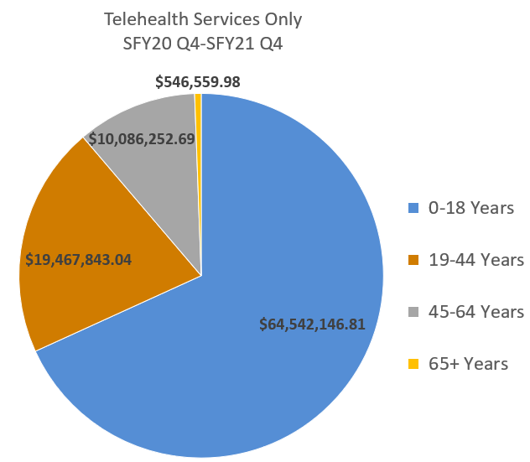
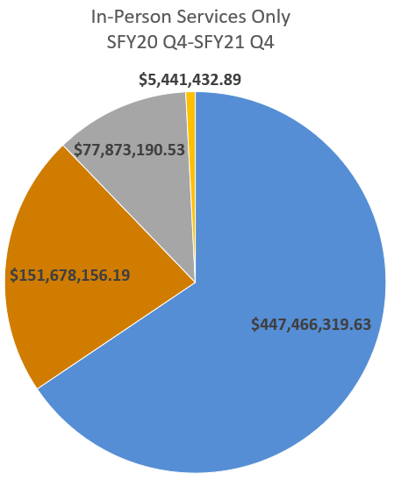
Expenditures by Age Group
Total = $94,642,803
Total = $682,459,099

Slide 9
SCDHHS Telemedicine Proviso Report
On October 1, 2021 SCDHHS submitted a report to the Legislature on the status of the telehealth program and the direction of telehealth policy as we emerge from the PHE.
The foremost priority identified in the report is continued evaluation of services that may achieve the department’s access, cost and quality goals.
Areas identified for additional review for possible policy addition:
Patient home as an approved referring location
Behavioral health provider type restrictions
Audio-only services

Slide 10
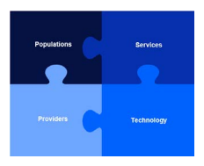
CMS State Medicaid Telehealth Toolkit
CMMS provided guidance for States evaluating telehealth post COVID-19
Guided Decision Points
Population
Service
Provider
Technology

Slide 11
Phases of Telehealth Changes
PHASE I - PHE Flexibilities:
Evaluation of PHE flexibilities
Decision to continue or discontinue
Policy/System updates
Provider communication
PHASE II - Future Initiatives:
School-based telehealth
Medically Complex Children

