Slide 1
South Carolina
Alliance of Health Plans Presentation
March 30, 2022

Slide 2
Who we are
The South Carolina Office of Rural Health is a non-profit organization with a mission to close the gap in health status between rural and urban communities. SCORH has been promoting investment, opportunity and health within rural communities since 1991.

Slide 3
About SCORH
Like its peer organizations in each state, the South Carolina Office of Rural Health is the sole organization in South Carolina that is federally designated to address the health needs in rural communities. SCORH works with local, state and national partners to:
• increase access to quality health care,
• improve the social determinants that contribute to a community’s overall health, and
• connect available resources across the state with local needs in rural communities.

Slide 4
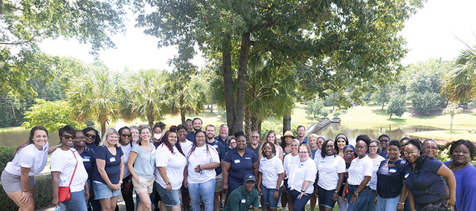
Our staff
40+ professionals in two offices
Lexington: Provider Services team and Community Support team, as well as our administrative, marketing and communications, HR, accounting, and leadership staff members.
Orangeburg: Family Solutions team (includes social workers, nurses, community health workers, client navigators, and program managers)

Slide 5
What we do
The South Carolina Office of Rural Health offers training, education and technical assistance
to rural providers.
We also empower rural communities
to address the social determinants of health
at the local level.

Slide 6
WHAT WE DO: PROVIDER SERVICES
Our staff offers technical assistance, education, live and virtual training sessions, and staff development for rural healthcare providers.
Center for Practice Transformation
We’re here to help rural practices thrive by implementing best practices for patient care and maximizing opportunities for reimbursement.
SCORH’s team guides rural primary care practices and Rural Health Clinics through the NCQA patient-centered medical home (PCMH) recognition.
In addition, the Center helps primary care providers implement oral care into their practice to reduce barriers to dental care in rural communities.
Center Activities
Site Visits
Practice & PCMH Assessment
Webinars & online access to resources
Individual consultations/ technical assistance
Face to face meetings

Slide 7
WHAT WE DO: PROVIDER SERVICES
Revolving Loan Fund
We provide low-interest loans to rural healthcare providers who need access to capital in order to make improvements to continue providing modern, appropriate care. These loans can cover construction/renovation, equipment, lines of credit and debt restructuring
Workforce Recruitment + Retention
We’re here to match medical professionals with opportunities to serve rural communities, and to help rural practices retain talented professionals.
This work is supported by the DHEC Office of Primary Care, SC Department of Health and Human Services, and SC Primary Healthcare Association.

Slide 8
WHAT WE DO: PROVIDER SERVICES
Rural Health Clinics
Rural Health Clinics (RHCs) fill the gaps in health care for communities without a nearby hospital. We help them interpret regulations and ensure compliance so they can continue meeting the needs of their patients.
Monitor rural health policy issues and keep apprised of changes affecting RHCs
Coordinate and sponsor workshops
On-site visits to RHCs to assist in billing, coding and programmatic issues
Assist providers considering converting to an RHC from initial application to final approval from CMS
Our team also provides these services to rural providers:
Choose Well: As one of South Carolina’s Choose Well partners, we help rural clinics integrate contraceptive access in primary care by providing contraceptive supplies, educational materials and staff training.
QPP: Our office can assist providers with attesting for Medicare’s Quality Payment Program (QPP). We offer free consultation to assist small practices (those with 15 or fewer clinicians) across South Carolina.

Slide 9
WHAT WE DO: PROVIDER SERVICES
Rural Hospitals
Small hospitals are often the cornerstone of health care in rural communities. We’re here to help them remain strong and viable.
The Medicare Rural Hospital Flexibility (Flex) Program and the Small Rural Hospital Improvement Grant Program (SHIP) allow SCORH to provide focused technical assistance to small rural hospitals.
Of 90 healthcare facilities across our state, there are currently 14 small, rural hospitals in South Carolina. Four of those are federally designated as Critical Access Hospitals.
Rural Emergency Services
When the nearest major hospital is an hour away, rural communities rely on emergency medical services (EMS) providers to be the first line of defense against illness or emergencies.
We provide tuition assistance, technical assistance, assessments, and training to make sure EMS providers are well trained to respond to any call.
What is a Critical Access Hospital (CAH)?
Must be 35 miles from nearest hospital unless certified previously as a “Necessary Provider”
No more than 25 beds (swing and acute)
Average length of stay must be less than 96 hours
4 CAHs in SC (Abbeville, Allendale, Edgefield and Williamsburg)

Slide 10
WHAT WE DO: COMUNITY SUPPORT
Behavioral Health
With a growing emphasis on behavioral health as an integral part of overall wellness, we are working across sectors and within communities to reduce the stigma of mental illness and substance use disorder.
We provide leadership to address substance use disorder (SUD) and opioid use disorder (OUD) in South Carolina’s rural communities through the Rural Communities Opioid Response Program (RCORP).
We participate in behavioral health coalitions across the state.
We support the agencies in each county that are working to provide behavioral health services at the local level.
Network Development
We are growing partnerships to ensure that all South Carolina residents get the care they need, regardless of insurance coverage or ability to pay. We build these local networks to foster shared services, workforce development, and access improvement initiatives. SCORH also provides education and development for local nonprofit governing boards.

Slide 11
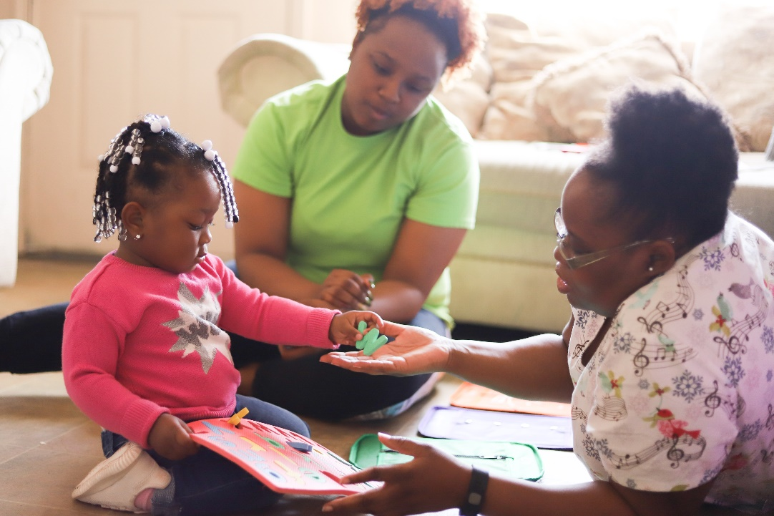
WHAT WE DO: COMMUNITY SUPPORT
Family Solutions
Every family deserves equal access to the healthcare system. Family Solutions is the home for Healthy Start and Nurse-Family Partnership, community-based initiatives that work to reduce infant mortality, expand community education and improve health outcomes for pregnant women and their families. With a history spanning two decades, Family Solutions has provided services to 24,000 women and families in Allendale, Bamberg, Barnwell, Calhoun, Hampton, and Orangeburg counties.
Services provided through these two programs include:
Case management & social work services
Home visits
Childbirth and breastfeeding classes
Reproductive health education
“Opportunity Knocks” fatherhood initiative
Motivational interviewing & goal-setting
Referrals for healthcare, childcare, job training and other support services available in the community

Slide 12
WHAT WE DO: COMMUNITY SUPPORT
Blueprint for Health
Provides technical assistance to 15 community coalitions serving 15 rural counties that includes:
Leadership Training
Capacity Building
Project Development
Results-Based Accountability Action Planning
Creation of a Vision for Community Health
Supported by the Blue Cross Blue Shield Foundation of South Carolina

Slide 13
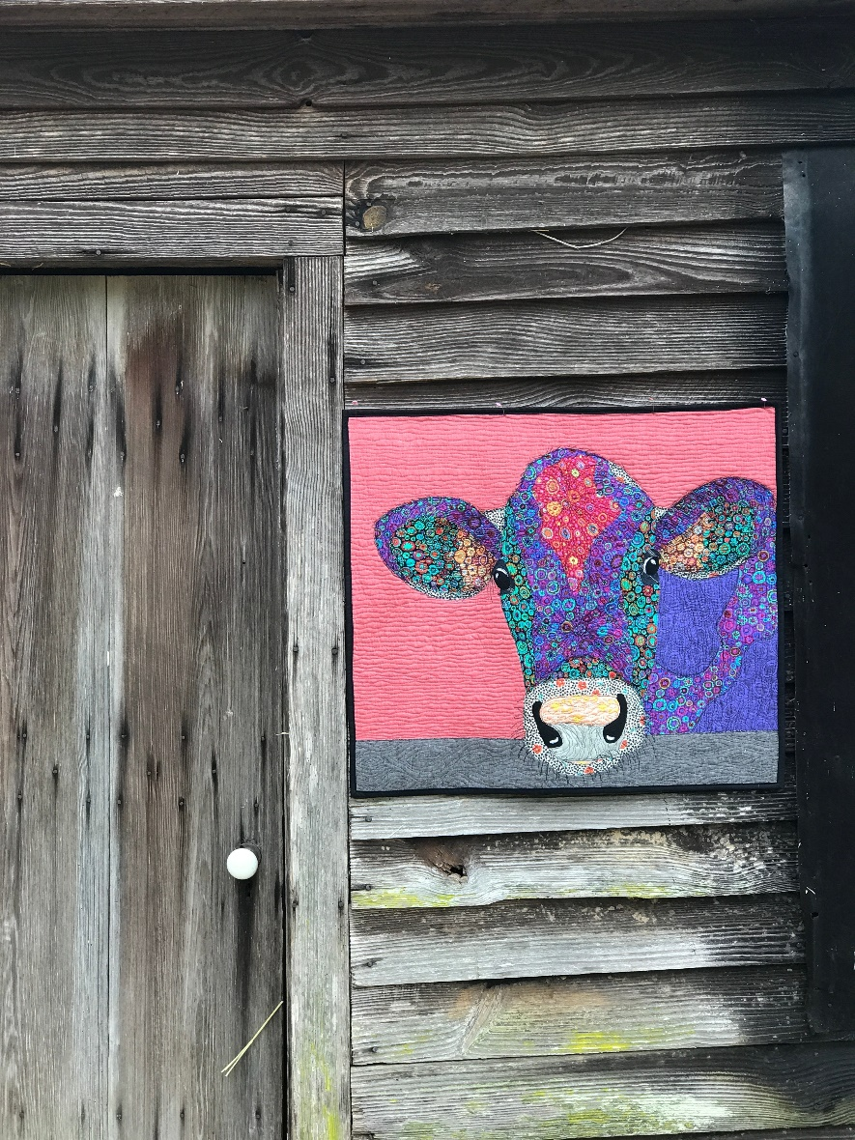
WHAT WE DO: COMMUNITY SUPPORT
Healthy People, Healthy Carolinas
Provides technical assistance for 10 community coalitions serving 16 counties to help them:
Build capacity to address long-term systemic health issues
Improve evidence-based intervention implementation
Apply continuous quality improvement practices
Plan for sustainability
Translate data into communication messages that catalyze action
Pursue policy, systems and environmental (PSE) changes
Onboard and develop coalition staff
Supported by The Duke Endowment in partnership with the SC Hospital Association

Slide 14
WHAT WE DO: COMMUNITY SUPPORT
Building Resilient & Inclusive Communities
Focuses on three areas:
Nutrition Security: Improve equitable access to healthy foods
Physical Activity Access: Enhance equitable access to safe places for physical activity
Social Connectedness: Promote opportunities to connect older adults who are socially isolated due to COVID-19
Provides technical assistance for 3 coalitions servicing 4 counties that includes:
Data Translation
Project Development
Results-Based Accountability Action Planning
Supported by SC DHEC

Slide 15
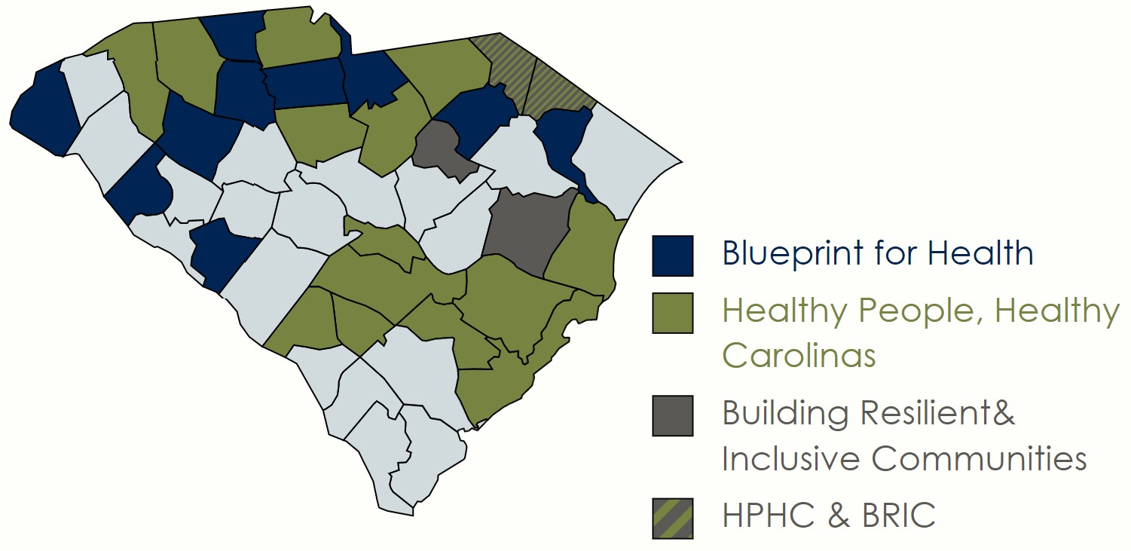
Where we do it we do It

Slide 16
Why we do it
With 27 percent of our state’s residents living in rural areas, the South Carolina Office of Rural Health believes in preserving and celebrating the unique character of rural communities.

Slide 17
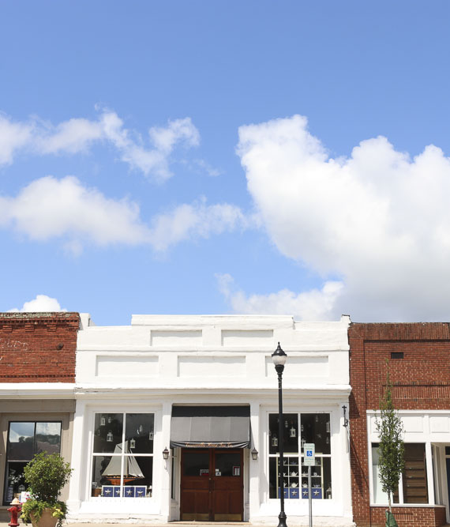
RuralForward SC
Nearly 1.4 million South Carolina residents call a rural community their home. RuralForward SC celebrates the unique character of rural communities and fosters collaborations to meet their needs.
It began in 2017 with the Rural Health Action Plan, a broad roadmap for improving the health status of our rural communities. This effort included input from community leaders across multiple sectors and resulted in 15 recommendations and 50+ action steps to guide collaborations between the health, housing, education and employment sectors.
RuralForwardSC puts the Rural Health Action Plan into motion, in our office and across the state, by:
Celebrating and replicating successful endeavors in rural communities in South Carolina and across the nation
Eliminating redundancies and breaking down silos between sectors
Providing financial and logistical support to innovative, cross-sector ideas
Coordinating existing federal, state and philanthropic assets

Slide 18
RuralForward SC
RuralForwardSC is what connects our mission to our communities
RuralForwardSC is the internal thread that runs through all the work we do, as we seek to improve the overall health of our rural communities.
RuralForwardSC represents the ways we tie together investment, opportunity and health.
RuralForwardSC evokes the idea of our work as part of a tapestry of work being done across the state in collaboration with multiple partners to improve outcomes and build rural prosperity.
RuralForwardSC is how we celebrate the unique culture of our rural communities, advocate on their behalf, and work to make them stronger and healthier.

Slide 19
RuralForward SC
RuralForwardSC elevates rural beyond the status quo,
and promotes a new mindset about what rural means
Areas of emerging focus include:
Digital Economy Ecosystem development
Rural entrepreneurship
Broadband access
Pro-rural messaging campaigns
Rural advocacy at the statehouse and Capitol Hill
Areas of potential focus include:
Coordinated rural philanthropy
Micro grants
Education
Makerspaces
Notes:
Visual element

Slide 20
CONTACT US
Graham Adams, PhD
Chief Executive Officer
adams@scorh.net

